Slide 1
Spatial Indexing

Slide 2
Spatial Queries
Given a collection of geometric objects (points, lines, polygons, ...)
organize them on disk, to answer
  point queries
  range queries
  k-nn queries
  spatial joins (‘all pairs’ queries)

Slide 3
Spatial Queries
Given a collection of geometric objects (points, lines, polygons, ...)
organize them on disk, to answer
  point queries
  range queries
  k-nn queries
  spatial joins (‘all pairs’ queries)

Slide 4
Spatial Joins
Spatial joins: find (quickly) all
counties intersecting lakes

Slide 5
R-trees – spatial join
We assume that both organized in R-trees using the MBRs
Find the MBRs that intersect
Check the original objects

Slide 6
R-tree – Spatial Joins
SPJ1(T1, T2)
for each parent P1 of tree T1
for each parent P2 of tree T2
if their MBRs intersect,
process them recursively (ie., check
their children)

Slide 7
R-tree – Spatial Joins
We assume that the trees have the same height
The traversal is done in DFS order

Slide 8
R-tree – Spatial Joins
Optimization:
SPJ2: First compute the intersection of nodes T1 and T2. Check for intersection only the rectangles in the intersection
Huge improvement on CPU time!

Slide 9
R-tree – Spatial Joins

Slide 10
R-tree – Spatial Joins
Is there any way to do better?
Yes, using plane sweep!
To check for intersection, naïve: O(n²)
But with plane sweep: O(n log n)

Slide 11
R-tree – Spatial Joins
Move a vertical line (sweep line) from left to right. Every time that you find a new object do some processing
Objects are sorted over their x-coordinate

Slide 12
R-tree – Spatial Joins
What happens if only one relation has an index?
Build another index on the other relation, then join
Use the first tree to build the second one: since we want to compute the join we can filter out some rectangle during the construction of the second tree!

Slide 13
Spatial Joins
Similar idea if we have z-ordering/ quadtrees
Merge the lists of z-ordering, use the properties of z-values (10* encloses 1001)

Slide 14
R-trees - performance analysis
How many disk (=node) accesses we’ll need for
  range
  nn
  spatial joins
why does it matter?

Slide 15
R-trees - performance analysis
How many disk (=node) accesses we’ll need for
  range
  nn
  spatial joins
why does it matter?
A: because we can design split etc algorithms accordingly; also, do query-optimization

Slide 16
R-trees - performance analysis
A: because we can design split etc algorithms accordingly; also, do query-optimization
motivating question: on, e.g., split, should we try to minimize the area (volume)? the perimeter? the overlap? or a weighted combination? why?

Slide 17
R-trees - performance analysis
How many disk accesses for range queries?
  query distribution wrt location?
  “ “ wrt size?

Slide 18
R-trees - performance analysis
How many disk accesses for range queries?
  query distribution wrt location? uniform; (biased)
  “ “ wrt size? uniform

Slide 19
R-trees - performance analysis
easier case: we know the positions of parent MBRs, eg:

Slide 20
R-trees - performance analysis
How many times will P1 be retrieved (unif. queries)?
x1
P1
x2

Slide 21
R-trees - performance analysis
How many times will P1 be retrieved (unif. POINT queries)?
x1
1
P1
x2
0
0
1

Slide 22
R-trees - performance analysis
How many times will P1 be retrieved (unif. POINT queries)? A: x1*x2
x1
1
P1
x2
0
0
1

Slide 23
R-trees - performance analysis
How many times will P1 be retrieved (unif. queries of size q1xq2)?
x1
1
P1
x2
q2
0
q1
0
1

Slide 24
R-trees - performance analysis
Minkowski sum
q2
q1
q1/2
q2/2

Slide 25
R-trees - performance analysis
How many times will P1 be retrieved (unif. queries of size q1xq2)? A: (x1+q1)*(x2+q2)
x1
1
P1
x2
q2
0
q1
0
1

Slide 26
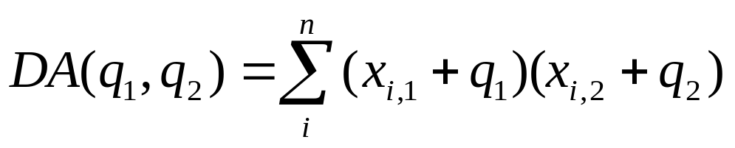
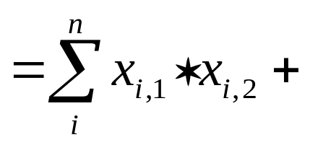
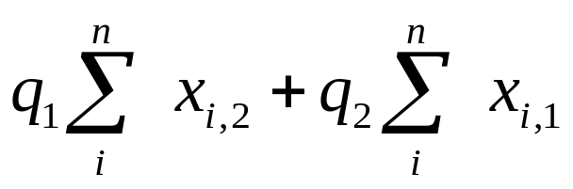
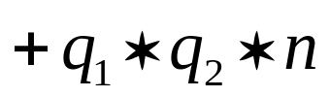
R-trees - performance analysis
Thus, given a tree with N nodes (i=1, ... N) we expect

Slide 27
R-trees - performance analysis
Thus, given a tree with N nodes (i=1, ... N) we expect
‘volume’
‘surface area’
count

Slide 28
R-trees - performance analysis
Observations:
for point queries: only volume matters
for horizontal-line queries: (q2=0): vertical length matters
for large queries (q1, q2 >> 0): the count N matters

Slide 29
R-trees - performance analysis
Observations (cont’ed)
overlap: does not seem to matter
formula: easily extendible to n dimensions
(for even more details: [Pagel +, PODS93], [Kamel+, CIKM93])

Slide 30
R-trees - performance analysis
Conclusions:
splits should try to minimize area and perimeter
ie., we want few, small, square-like parent MBRs
rule of thumb: shoot for queries with q1=q2 = 0.1 (or =0.5 or so).

Slide 31
R-trees - performance analysis
How many disk (=node) accesses we’ll need for
  range
  nn
  spatial joins

Slide 32
R-trees - performance analysis
Range queries - how many disk accesses, if we just now that we have
- N points in n-d space?
A: ?

Slide 33
R-trees - performance analysis
Range queries - how many disk accesses, if we just now that we have
- N points in n-d space?
A: can not tell! need to know distribution

Slide 34
R-trees - performance analysis
What are obvious and/or realistic distributions?

Slide 35
R-trees - performance analysis
What are obvious and/or realistic distributions?
A: uniform
A: Gaussian / mixture of Gaussians
A: self-similar / fractal. Fractal dimension ~ intrinsic dimension

Slide 36
R-trees - performance analysis
Formulas for range queries and k-nn queries: use fractal dimension [Kamel+, PODS94], [Korn+ ICDE2000] [Kriegel+, PODS97]
Formulas for spatial joins of regions: open research question

Slide 37
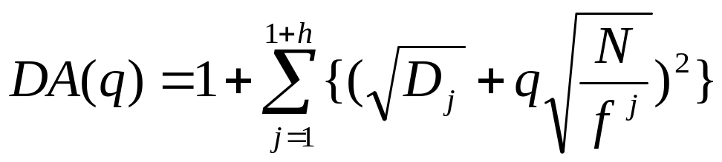
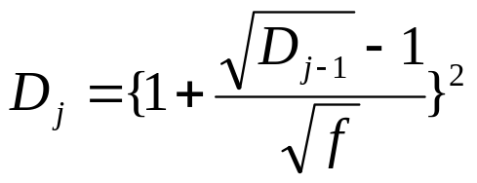
R-trees–performance analysis
Assuming Uniform distribution:
where
And D is the density of the dataset, f the fanout [TS96], N the number of objects

Slide 38
Dimensionality ‘curse’
Q: What is the problem in high-d?

Slide 39
Dimensionality ‘curse’
Q: What is the problem in high-d?
A: indices do not seem to help, for many queries (eg., k-nn)
  in high-d (& uniform distributions), most points are equidistant -> k-nn retrieves too many near-neighbors
  [Yao & Yao, ’85]: search effort ~ O( N ^{(1-1/d)} )

Slide 40
Dimensionality ‘curse’
(counter-intuitive, for db mentality)
Q: What to do, then?

Slide 41
Dimensionality ‘curse’
A1: switch to seq. scanning
A2: dim. reduction
A3: consider the ‘intrinsic’/fractal dimensionality
A4: find approximate nn

Slide 42
Dimensionality ‘curse’
A1: switch to seq. scanning
  X-trees [Kriegel+, VLDB 96]
  VA-files [Schek+, VLDB 98]

Slide 43
Dimensionality ‘curse’
A1: switch to seq. scanning
A2: dim. reduction
A3: consider the ‘intrinsic’/fractal dimensionality
A4: find approximate nn

Slide 44
Dim. reduction
a.k.a. feature selection/extraction:
SVD (optimal, to preserve Euclidean distances)
random projections
using the fractal dimension [Traina+ SBBD2000]

Slide 45
Singular Value Decomposition (SVD)
SVD (~LSI ~ KL ~ PCA ~ spectral analysis...)
LSI: S. Dumais; M. Berry
KL: eg, Duda+Hart
PCA: eg., Jolliffe
MANY more details: soon

Slide 46
Random projections
random projections(Johnson-Lindenstrauss thm [Papadimitriou+ pods98])

Slide 47
Random projections
pick ‘enough’ random directions (will be ~orthogonal, in high-d!!)
distances are preserved probabilistically, within epsilon
(also, use as a pre-processing step for SVD [Papadimitriou+ PODS98]

Slide 48
Dim. reduction - w/ fractals
Main idea: drop those attributes that don’t affect the intrinsic (‘fractal’) dimensionality [Traina+, SBBD 2000]

Slide 49
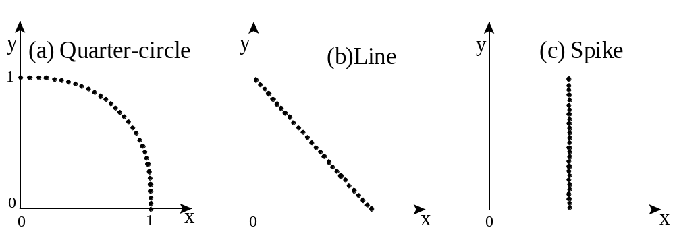
Dim. reduction - w/ fractals
global FD=1
PFD~1
PFD~1

Slide 50
Dimensionality ‘curse’
A1: switch to seq. scanning
A2: dim. reduction
A3: consider the ‘intrinsic’/fractal dimensionality
A4: find approximate nn

Slide 51
Intrinsic dimensionality
before we give up, compute the intrinsic dim.:
the lower, the better... [Pagel+, ICDE 2000]
more details: under ‘fractals’
intr. d = 2
intr. d = 1

Slide 52
Dimensionality ‘curse’
A1: switch to seq. scanning
A2: dim. reduction
A3: consider the ‘intrinsic’/fractal dimensionality
A4: find approximate nn

Slide 53
Approximate nn
[Arya + Mount, SODA93], [Patella+ ICDE 2000]
Idea: find k neighbors, such that the distance of the k-th one is guaranteed to be within epsilon of the actual.

